Slide 1
Deepening understanding of place value in integers
Place value

Slide 2
how to use Oak lessons

Slide 3
I can state the value of any digit in any given integer in any given form.

Slide 4
A digit is one of the symbols of a number system. In our number system we use the digits 0, 1, 2, 3, 4, 5, 6, 7, 8 and 9.
An integer is any positive or negative whole number or zero. E.g. -2, 0, 153 are all examples of integers.

Slide 5

Deepening understanding of place value in integers
Read integers aloud and consider the context
Write an integer described in different ways

Slide 6





Read integers aloud and consider the context
Say this integer aloud
1 000 000
Lucas, Aisha and Laura read this integer aloud. Who says it correctly?
I think it’s
1000
thousands
That’s 10
hundred thousands
It’s 1 million
Lucas
Aisha
Laura

Slide 7
Read integers aloud and consider the context
HM | TM | M | HTh | TTh | Th | H | T | O
1 million
1
0
0
0
0
0
0
1000 thousands
1
0
0
0
0
0
0
10 hundred thousands
1
0
0
0
0
0
0

Slide 8

Read integers aloud and consider the context
Select the correct ways of saying 1 250 000
one million two hundred and fifty thousand
one thousand two hundred and fifty hundreds
twelve thousand five hundred hundreds
one thousand two hundred and fifty thousands

Slide 9

Read integers aloud and consider the context
Sam is opening a bank account and needs to give their mobile number.
It’s 7 million, 3 hundred thousand. Wait, no that’s not right. Hmm?
Would you be able to say your mobile number as an integer?
Sometimes we adapt the way we say numbers based on the situation.

Slide 10
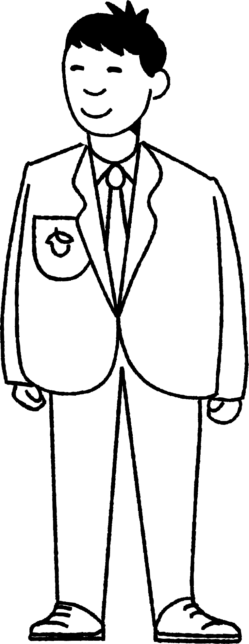
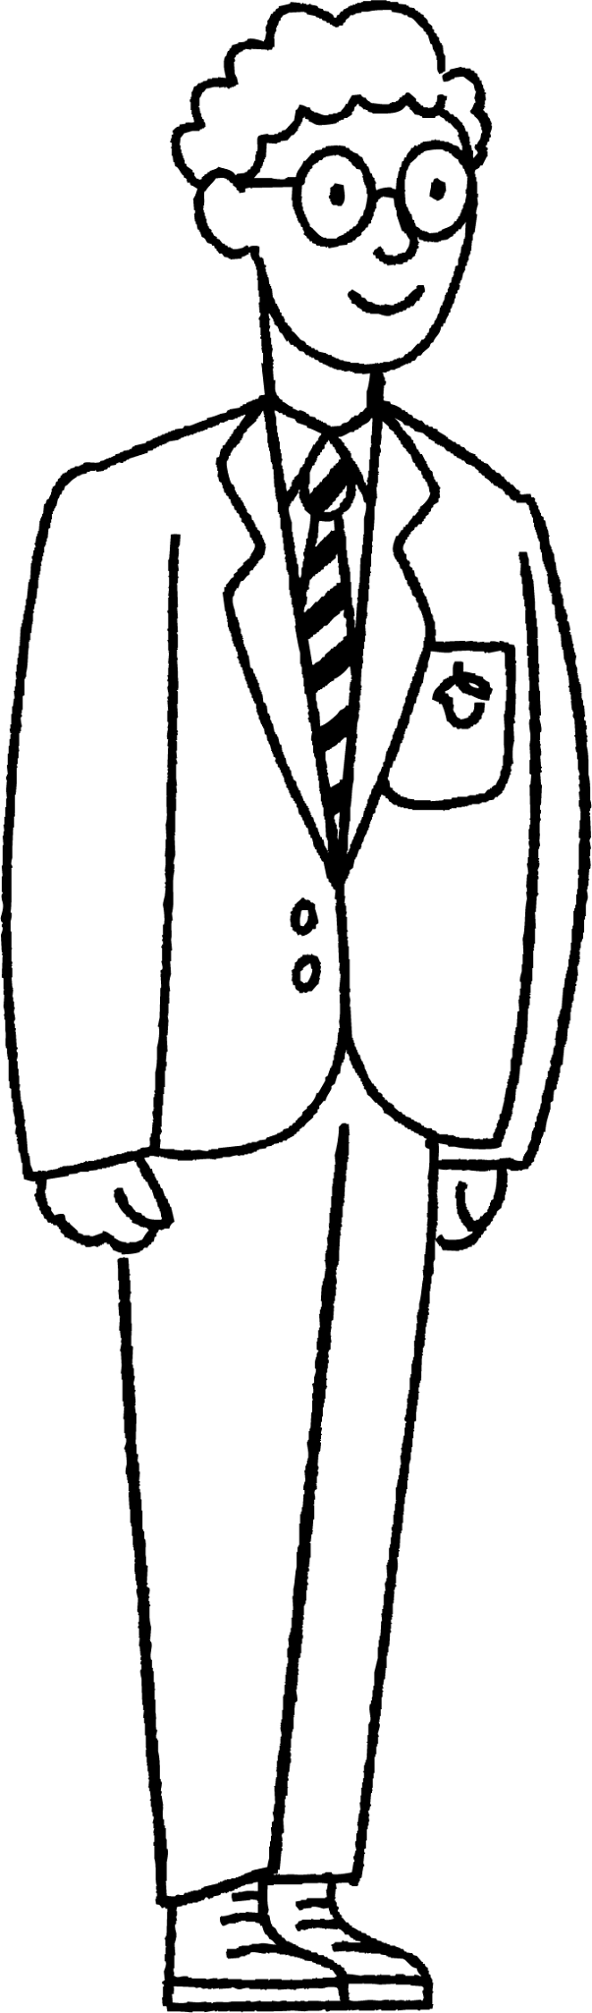
Read integers aloud and consider the context
Jun asks Alex to measure their height.
You mean I am one hundred and fifty seven centimetres tall.
You’re one five seven centimetres tall.

Slide 11


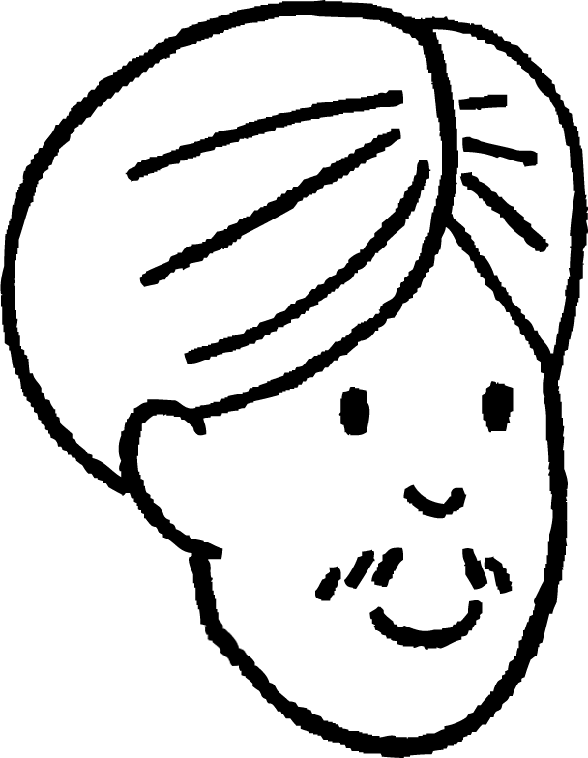

Read integers aloud and consider the context
What are the integers referred to in each of these statements?
I ran 5k at the weekend.
My mum’s new
car cost 10 grand.
Izzy
Jacob
I am running the fifteen hundred metres on sports day.
Sofia
My new house cost a quarter of a million.
Andeep

Slide 12
Read integers aloud and consider the context
I ran 5k at the weekend.
Izzy
Often, when talking about distance, people use the letter ‘k’ to represent 1000.
So, Izzy ran 5000 metres.

Slide 13
Read integers aloud and consider the context
My mum’s new
car cost 10 grand.
Jacob
Sometimes, when talking about money, people use the word ‘grand’ to represent 1000.
So, Jacob’s mum’s car cost £10 000.

Slide 14
Read integers aloud and consider the context
My new house cost
a quarter of a million.
Sofia
When talking about bigger integers we sometimes compare them to a million.
So, Sofia’s house cost one quarter of £1 000 000, which is £250 000.

Slide 15
Read integers aloud and consider the context
I am running the fifteen hundred metres on sports day.
Andeep
How far will Andeep run?
Andeep will run 1500 metres.

Slide 16
Read integers aloud and consider the context
Match the pairs.
50k
half a million
5 grand
500 000
5000
50 000

Slide 17
Read integers aloud and consider the context
1) Fill in the missing integers or words.
a) 300 000 = 300 = hundreds = 30 000 .
b) 45 000 = thousands = 450 = tens
c) 5 600 000 = 100 thousands = 560 = hundreds
d) 84 500 000 = 8450 = tens = millions

Slide 18
Read integers aloud and consider the context
1) Fill in the missing integers or words.
a) 300 000 = 300 thousands = 3000 hundreds = 30 000 tens
b) 45 000 = 45 thousands = 450 hundreds = 4500 tens
c) 5 600 000 = 56 100 thousands = 560 10 thousands = 56 000 hundreds
d) 84 500 000 = 8450 10 thousands = 8 450 000 tens = 84.5 millions

Slide 19
Deepening understanding of place value in integers
Read integers aloud and consider the context
Write an integer described in different ways

Slide 20
Write an integer described in different ways
Write 19 hundreds as an integer.
HM | TM | M | HTh | TTh | Th | H | T | O
1
9
0
0
19 hundreds as an integer is one thousand nine hundred.

Slide 21
Write an integer described in different ways
Write 145 tens as an integer.
HM | TM | M | HTh | TTh | Th | H | T | O
1
4
5
0
145 tens as an integer is one thousand, four hundred and fifty.

Slide 22
Write an integer described in different ways
Write 54 ten thousands as an integer.
HM | TM | M | HTh | TTh | Th | H | T | O
5
4
0
0
0
0
54 ten thousands as an integer is five hundred and forty thousand.

Slide 23
Write an integer described in different ways
HM | TM | M | HTh | TTh | Th | H | T | O
25 ten thousands is equal to 2500 tens
The 2s do not have the same place value.
The 2s have the same place value.

Slide 24
Write an integer described in different ways
1) Find the odd one out in each set.
a)
40 thousands | 40 ten thousands | 4000 tens | 400 hundreds
6 million | 600 000 tens | 60 000 thousands | 60 hundred thousands
1200 tens | 120 thousands | 12 ten thousands | 1200 hundreds
5780 ten thousands | 5 780 000 tens | 578 000 hundreds | 578 million
8.4 million | 840 ten thousands | 8400 hundreds | 84 hundred thousands
b)
c)
d)
e)

Slide 25
Write an integer described in different ways
2) Use all the digit cards to create:
a) an integer with 76 hundreds
b) an integer with 976 hundreds
c) an integer with 76 tens
d) an integer with 90 hundreds
9
7
0
6
8

Slide 26
Write an integer described in different ways
1) Find the odd one out in each set.
a)
40 thousands | 40 ten thousands | 4000 tens | 400 hundreds
6 million | 600 000 tens | 60 000 thousands | 60 hundred thousands
1200 tens | 120 thousands | 12 ten thousands | 1200 hundreds
5780 ten thousands | 5 780 000 tens | 578 000 hundreds | 578 million
8.4 million | 840 ten thousands | 8400 hundreds | 84 hundred thousands
b)
c)
d)
e)

Slide 27
Write an integer described in different ways
2) Use all the digit cards to create:
a) an integer with 76 hundreds e.g. 87 609
b) an integer with 976 hundreds e.g. 97 680
c) an integer with 76 tens e.g. 90 768
d) an integer with 90 hundreds e.g. 79 068
9
7
0
6
8

Slide 28
Deepening understanding of place value in integers
Integers can be read aloud in different ways.
The way integers can be read aloud may be affected by context.
By using its digits, an integer can be written in different ways when described.

Slide 29

© Oak National Academy 2023.
Produced in partnership with Mathematics in Education and Industry.
Licensed on the Open Government Licence v3.0, except where otherwise stated. See Oak terms and conditions.

